Slide 1
HR Analytics Dashboard PPT
Technohacks Internship Task 6

Slide 2
HR Analytics Dashboard
Understanding Key Factors Behind Employee Attrition
Presented by: Pranav Patel

Slide 3

Project Scope
Objective: To identify major factors contributing to employee attrition using data visualizations and analysis in Power BI.

Slide 4
Data Cleaning & Preprocessing
Checked for and removed missing values
Removed duplicates
Fixed spelling errors using Find & Replace
Ensured correct data types
Created binary columns (1 = Yes, 0 = No) for logical operations

Slide 5

DAX Calculation
Attrition Rate Formula:
Attrition Rate = SUM(hr_analytics[Attrition Count]) / SUM(hr_analytics[Employee Count])

Slide 6

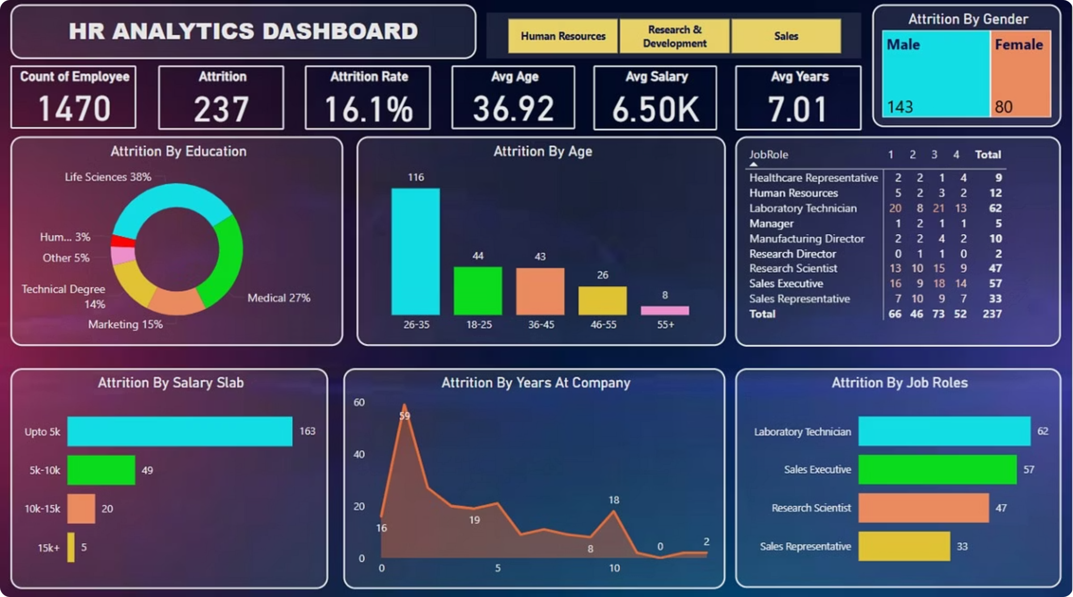
Dashboard Visuals
Donut Chart – Attrition by Education
Stacked Bar – Attrition by Top 4 Job Roles
Stacked Column Chart – Attrition by Age
Area Chart – Years at Company
Matrix Table – Job Role vs. Job Satisfaction
Treemap – Gender-wise Attrition
Stacked Bar Chart – Attrition by Salary Slab
Slicers – Department Filter (HR, R&D, Sales)

Slide 7
Key Insights
Age Group
Salary Impact
Tenure
Highest attrition among 26–35 age group.
163 employees earning <5K left (below avg salary of 6.5K).
59 employees left after just 1 year.
Job Satisfaction
Gender Attrition
Lab Technicians gave lowest job satisfaction before leaving.
Male attrition higher than female.

Slide 8


Tools Used
Microsoft Excel
Power BI

Slide 9
Learnings
Data Storytelling
Insight Extraction
Understood practical impact of data-driven storytelling.
Dashboard Design
Improved ability to extract insights from raw HR data.
Gained skills in interactive dashboard design.

